Slide 1

Team Details
Team name: B3
Team leader name: Arsh Chand
Problem statement: Providing Farmers with Expert Help on Demand

Slide 2
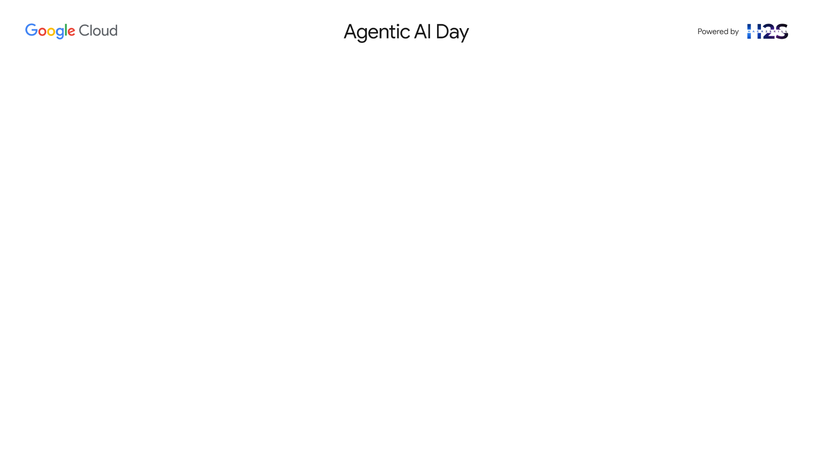
Project Kisan : Brief about the idea
Small-scale farmers in Karnataka face many challenges every day, from crop diseases and changing weather to unfair market prices. Project Kisan is an easy-to-use AI assistant on a mobile phone that helps them solve these problems. The most important part is how the farmer interacts with it. They don't need to type or read complex screens; they can simply talk to the assistant. We have put a special focus on providing a perfect Kannada experience to make it the most helpful tool for farmers in Karnataka. At the same time, the assistant is also built to understand both Hindi and English, making the platform powerful and ready to help farmers in other regions as well. The assistant provides four critical services with equal importance.
First, if a farmer sees a problem on a plant, they can just take a picture. The voice assistant then uses AI to analyze the photo, immediately tells them the exact name of the disease or pest, and clearly explains what affordable, local medicines they can use to save their crop.
Second, before selling their produce, they can ask the assistant, "What is the price of tomatoes today?" It will instantly reply with the live buying rates from their nearest mandi, also mentioning if the price is higher or lower than last week, so they have the power to negotiate and sell at the most profitable time.
Third, the assistant acts as a 24/7 lookout, constantly monitoring local weather forecasts. It will send proactive pop-up alerts directly to the farmer's phone for specific risks like hailstorms, heatwaves, or sudden heavy rains, giving them crucial hours to take protective measures and prevent devastating losses.
Finally, the assistant helps them navigate the often-confusing world of government support. A farmer can simply ask about getting a government subsidy for buying seeds or installing a new pump, and the assistant will explain the relevant schemes, what documents are needed, and how to apply, unlocking financial support they are entitled to.
By bringing all these capabilities together through a simple voice conversation, Project Kisan gives the farmer more control, helps them save their crops, earn more money, and take full advantage of available government programs.

Slide 3
Opportunities
How different is it from any of the other existing ideas?
1. Beyond a Single Feature: The Power of True Integration
Existing apps force a farmer to be a user of multiple, disconnected services. They might use one app for disease diagnosis, another for checking market prices, and a government website for subsidies. But a farmer's problems aren't separate; they are deeply interconnected.
Project Kisan is the only solution that mirrors this reality. We have built a single, seamless conversational AI that integrates the three most critical aspects of a farmer’s life: their Crop Health, their Market Income, and their Financial Support
2. The Value of Hyper-Local Intelligence
Other platforms offer generic, national-level data. A farmer in Belagavi doesn't care about the average tomato price in all of India. That data is noise, not a signal.
Our advantage is actionable, hyper-local intelligence.
Our disease remedies recommend pesticides available in the local stores.
Our market analysis compares prices between the Hubli and Kolar mandis, not Delhi and Mumbai.
Our navigator explains Karnataka state government subsidies, not just central schemes.
3. We Deliver a True Local Language Experience
Our commitment to local language, especially Kannada, is not just a translation feature; it is the core of our entire technical architecture. We’ve ideated an end-to-end, three-step pipeline using Google's state-of-the-art AI services to ensure the conversation is seamless, natural, and instant.

Slide 4
Opportunities
How will it be able to solve the problem?
Project Kisan directly tackles each of the farmer's most critical points with a specific, targeted solution.
Problem: Farmers lose a significant portion of their harvest because they can't identify crop diseases quickly.
Our Solution: The Visual Crop Doctor provides an instant diagnosis from a simple smartphone photo. It immediately suggests affordable, locally available remedies, turning weeks of waiting and uncertainty into seconds of actionable advice, directly preventing crop loss.
Problem: Farmers are often forced to sell their produce at low prices because they lack real-time information from the local mandis (markets).
Our Solution: The Live Mandi Prices feature empowers the farmer with knowledge. By simply asking in their own voice, they get current rates from multiple nearby markets, allowing them to negotiate better, choose the most profitable location, and maximize their income.
Problem: Sudden and extreme weather events like hailstorms or heatwaves can destroy an entire season's hard work without any warning.
Our Solution: Weather Alerts act as a digital watchtower. Our system sends timely, easy-to-understand notifications directly to the farmer’s phone, giving them a crucial window to take protective measures like covering crops or adjusting irrigation.
Problem: Valuable government subsidies are often missed because the information is complex, hard to find, and not available in the local language.
Our Solution: The Subsidy Navigator functions as a simple guide. It breaks down complicated government schemes, explains the eligibility and application steps in simple Kannada, and helps farmers unlock the financial support they are entitled to.

Slide 5
Opportunities
USP of the proposed solution
1. The "Translator" Angle
Other apps give farmers data. We give them wisdom. Project Kisan's unique proposition is that it acts as a universal translator, converting the complex, intimidating languages of science, markets, and bureaucracy into the simple, spoken advice of a single, trusted friend.
2. The "Signal" Angle
In a world of digital noise and information overload, Project Kisan's USP is to be the farmer's one true signal. We filter out irrelevant national data, complex scientific jargon, and confusing policies to deliver only what matters: a clear, personalized, and immediate answer that guides their next right action.
3. The "Swiss Army Knife" Angle
While competitors offer a single tool, Project Kisan's USP is to be the farmer's ultimate multi-tool: a Swiss Army Knife in their pocket. It’s an agronomist when their crop is sick, a stockbroker when it’s time to sell, and a policy expert when they need support—all instantly available through a single voice command.

Slide 6
List of features offered by the solution
Instant photo diagnosis to identify crop diseases and pests.
A visual library of plant diseases for manual identification help.
Real-time price checks for multiple crops across local mandis.
Voice-activated commands to ask for any market rate.
Proactive pop-up alerts for upcoming extreme weather events.
Specific warnings for hailstorms, heatwaves, and frost.
Advance notifications for heavy rainfall to prevent water-logging.
Easy-to-understand explanations of government subsidy programs.
Clear guidance on the eligibility criteria for each scheme.
A checklist of required documents for subsidy applications.
Fully hands-free operation through a voice-controlled interface.
Expert-level support and understanding of the Kannada language.
Full voice functionality also available in Hindi and English.
Natural, human-like voice responses for clear communication.
Personalized dashboard tailored to the farmer’s specific crops and location.
Secure and simple login using only a mobile phone number.
Optimized for low data usage in areas with poor internet connectivity.

Slide 7
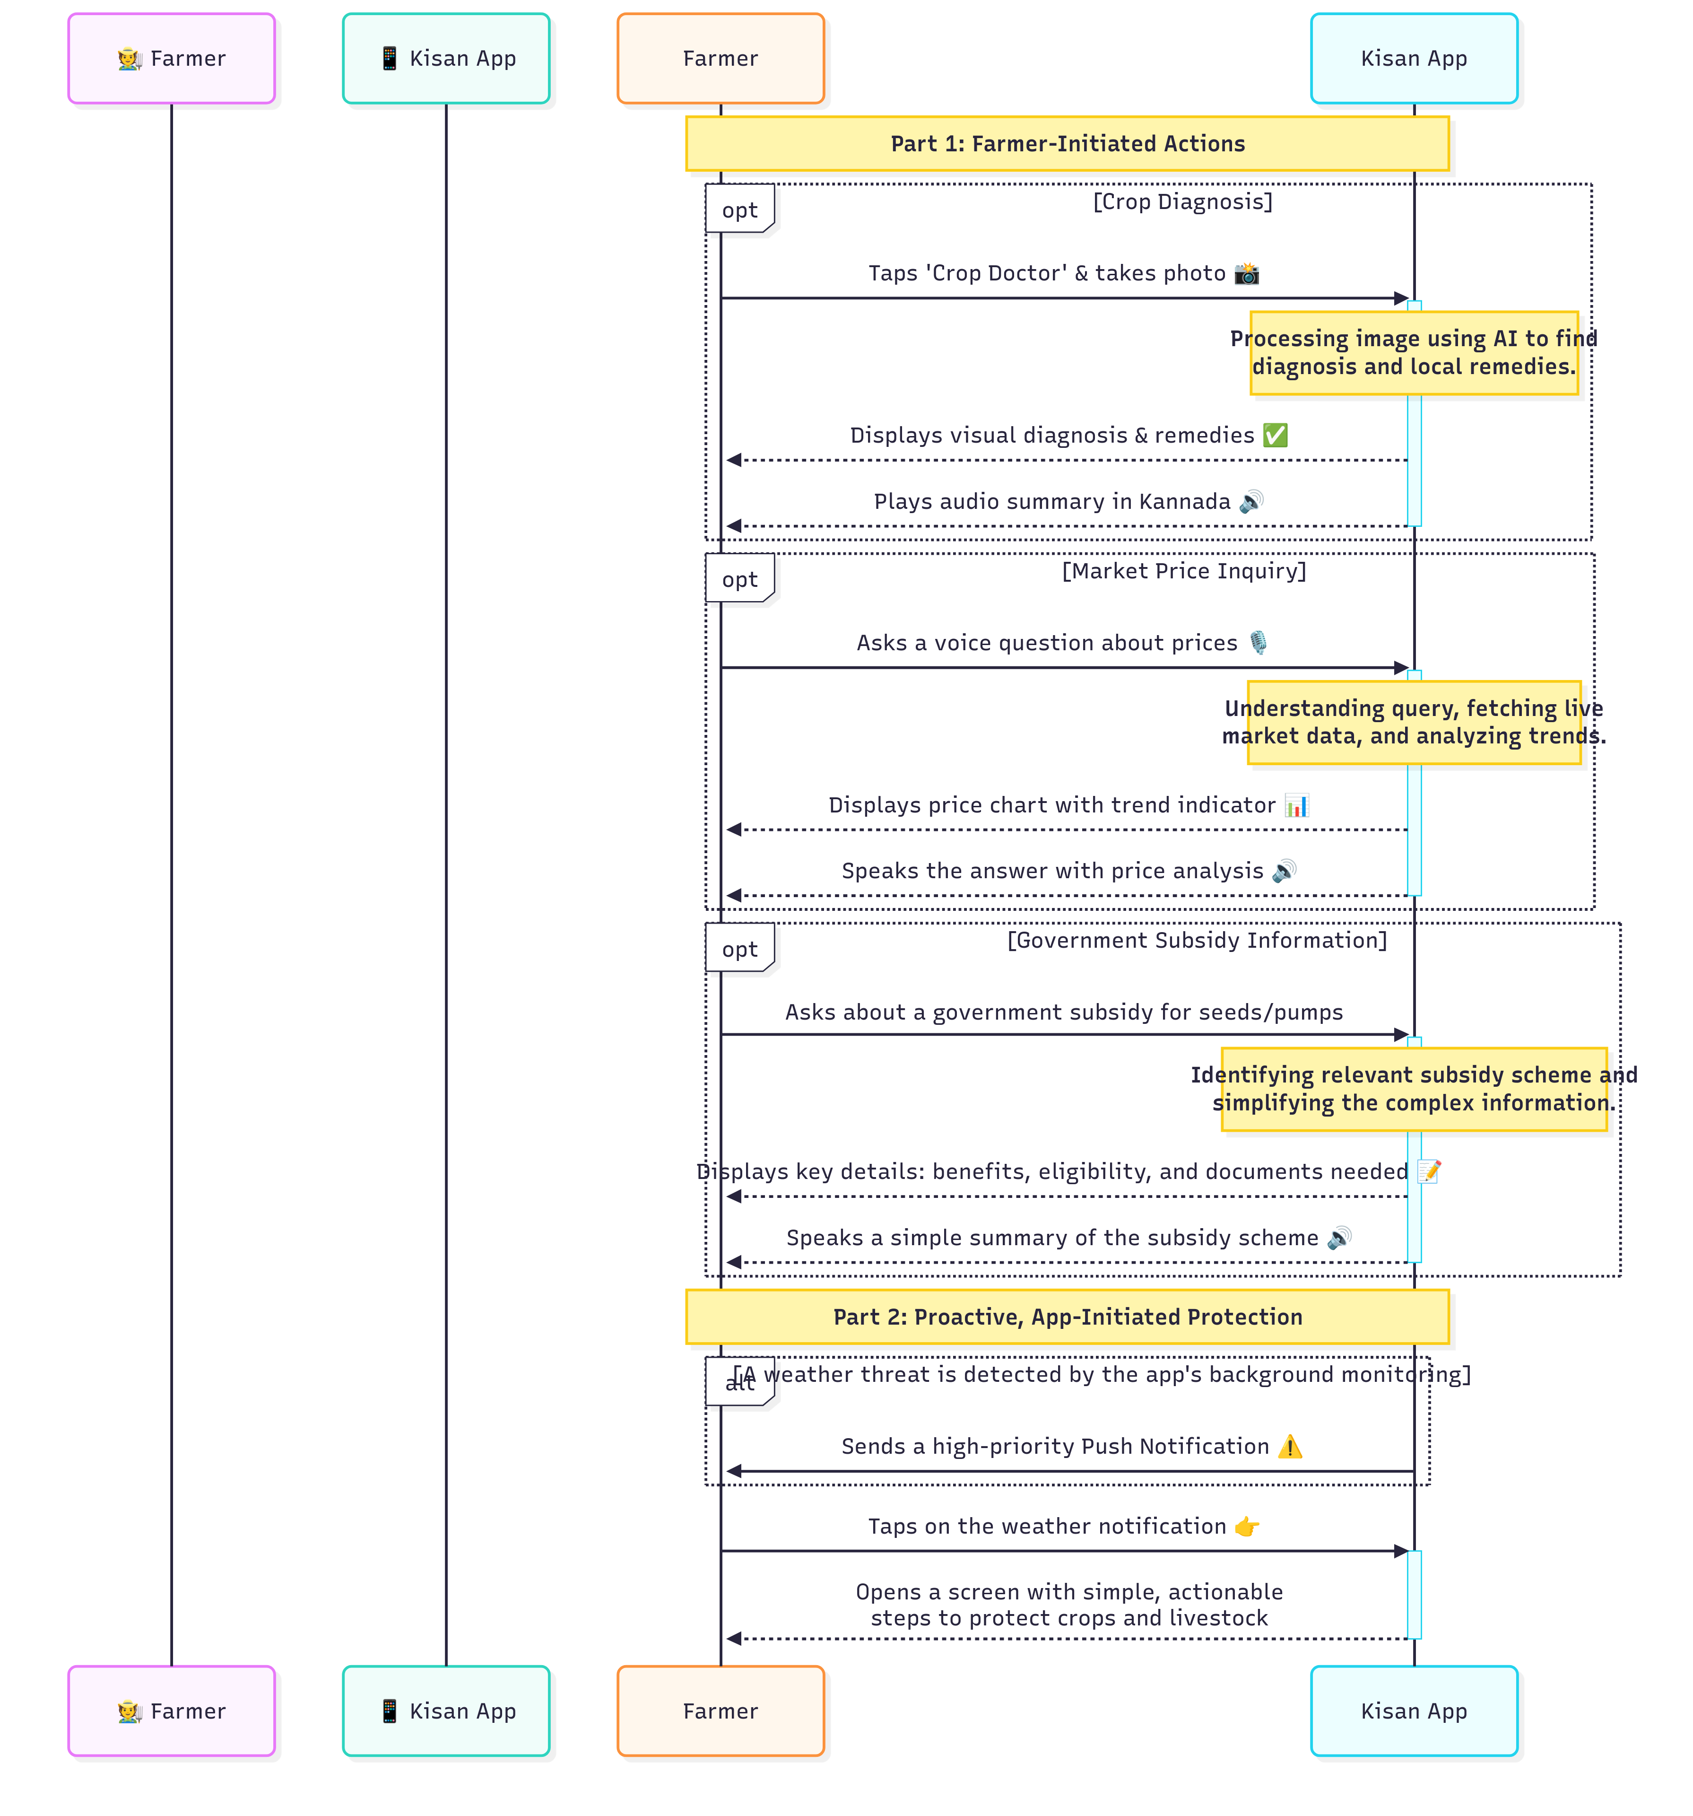
Process flow diagram or use-case diagram

Slide 8
Technologies to be used in the solution
Frontend
React.js: The core library for building our fast, mobile-first Progressive Web App (PWA) interface.
PWA Features: to enable app-like features like installing to the home screen, offline access, and push notifications via service workers.
Firebase Hosting: for deploying our PWA globally with speed, security, and a built-in CDN.
Backend
Node.js & Express.js: to build our core backend API to handle all business logic and requests.
Google Cloud Run: platform to deploy and automatically scale our Node.js backend container.
Database
Google Cloud Firestore: scalable NoSQL database for storing user profiles and application data.
Firebase Realtime Database: will provide ultra low-latency data sync, good for our live market price feature.
AI & Machine Learning (The Brain)
Vertex AI (Gemini Pro Vision): to analyse farmer's crop photos to diagnose diseases.
Vertex AI (Gemini Pro): The reasoning engine for understanding questions and summarizing information.
Vertex AI (Speech-to-Text): to convert spoken commands in Kannada, Hindi, & English to text.
Vertex AI (Text-to-Speech): to generate clear, natural-sounding voice responses for the farmer.
Essential Cloud Services
Firebase Authentication: for providing secure and easy user login using a phone number (OTP).
Firebase Cloud Messaging (FCM): to deliver the critical, proactive weather alert push notifications.
Google Cloud Scheduler: job scheduler to triggers our background weather checks.

Slide 9
Architecture diagram of the proposed solution

Slide 10
Wireframes/Mock diagrams of the proposed solution (optional)

Slide 12


